Slide 1
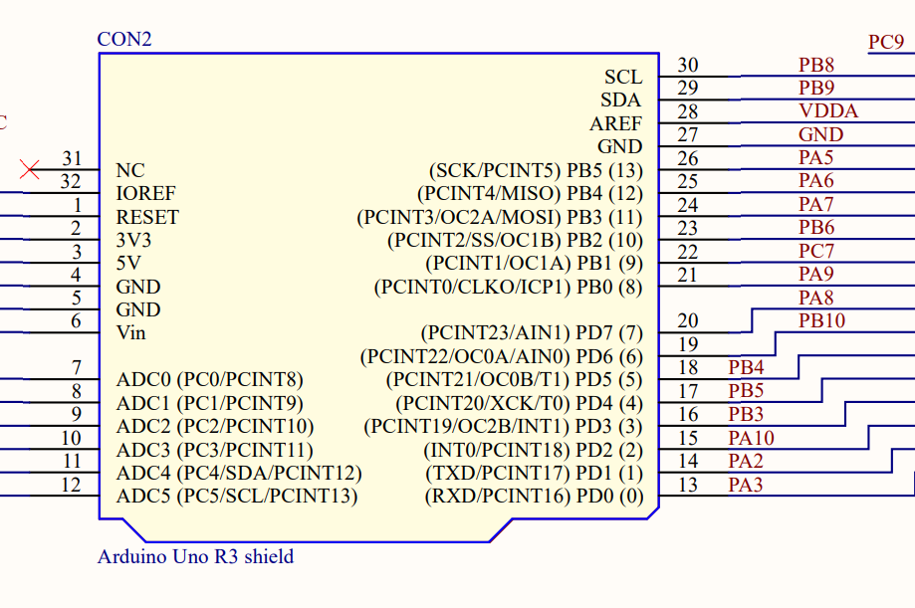
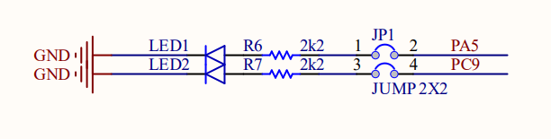
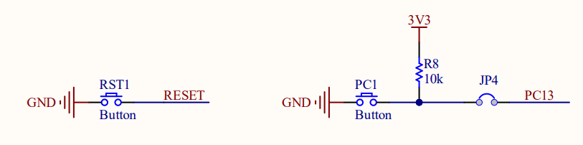
Exercise on STM32F103RB

Slide 2
STM32F103RB Schematic

Slide 3
First Program on STM32F103RB
Blinky LED1(PA5) and LED2(PC9) every 2 seconds
  Hint: HAL_GPIO_Toggle in while(1)
Blinky LED1(PA5) every 2 seconds using timer interrupt
  Hint: Use a counter
Scan LED1 and LED2 with 50Hz

Slide 4
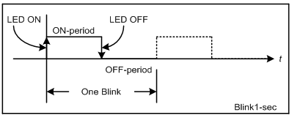
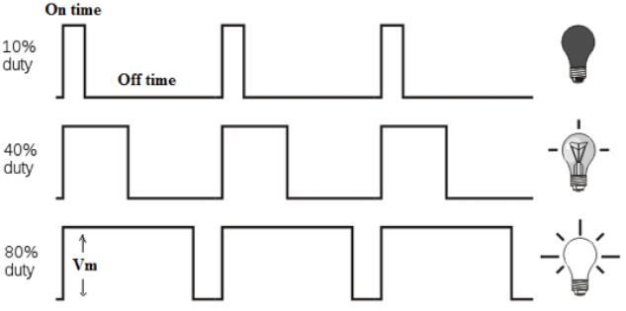
LED Blinky
Cycle (T) = On-period + OFF-period (s)
Frequency (F) = 1 /T (Hz)
Duty Cycle = ON-period/T (%)

Slide 5
Exercise
Configure Timer2 Interrupt for every (Cycle T =) 10ms
Generate a pulse on PA5 having freq = 50Hz and Duty Cycle = 50%

Slide 6
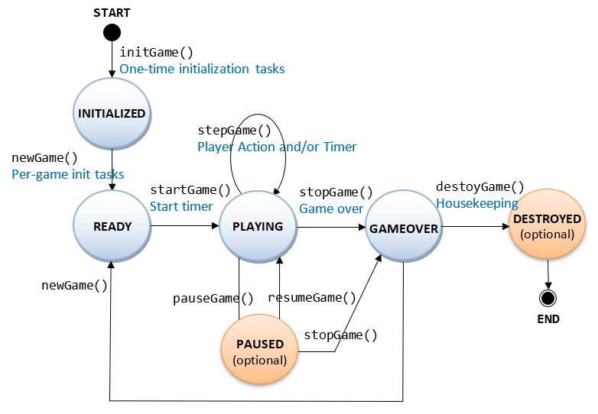
State Machine
A state machine is a behavior model. It consists of a finite number of states and is therefore also called finite-state machine (FSM). Based on the current state and a given input the machine performs state transitions and produces outputs.

Slide 7
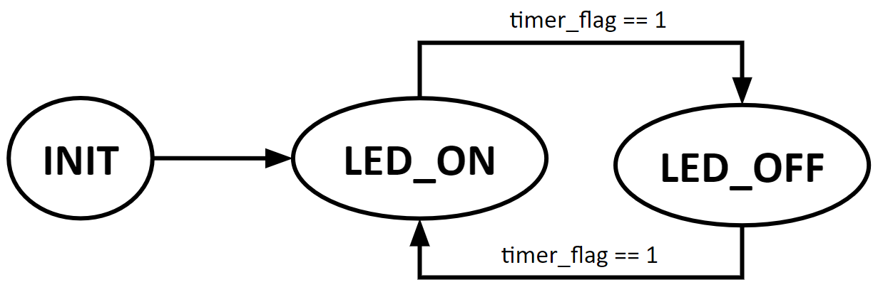
LED BLinky
Given an LED turns on for T_on = 2s and then turns off for T_off = 3s.
  Design an DFA for this LED
  Implement the DFA in STM32F103RB

Slide 8
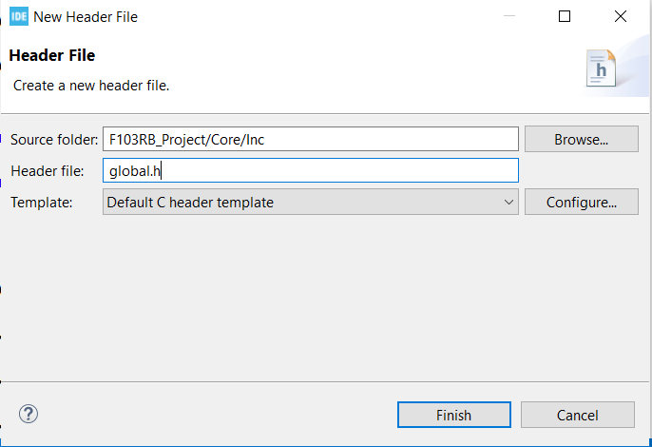
Create global.h
Define some constants, global variables

Slide 9
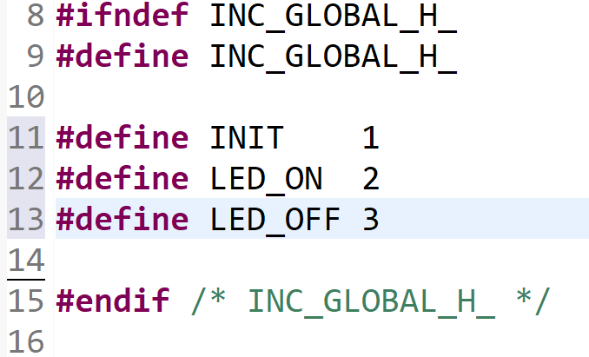
Implement global.h

